Slide 1

VIRTUAL MOUSE

Slide 2
TEAM MEMBERS
Sr. No.
First Name
Middle Name
Surname
Enrollment No.
1
Vishal
Bhimgonda
Desai
2109650128
2
Rakesh
Mahadev
Bandi
2109650125
3
Prajwal
Sadashiv
Chilami
2109650133
4
Rohit
Sanjay
Gorule
2109650126

Slide 3
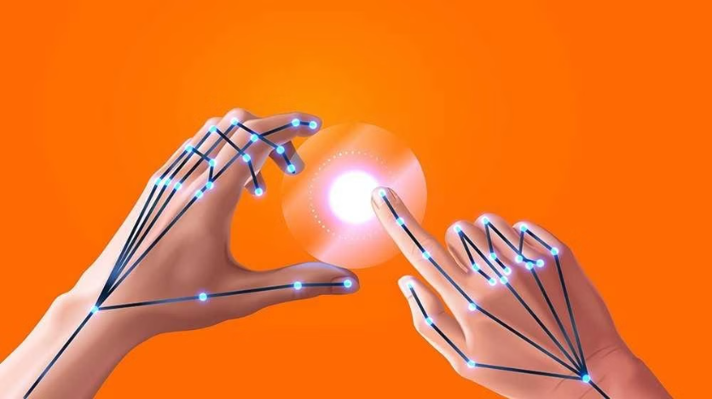
Virtual Mouse
A virtual mouse is a software-based input device that allows users to control their computer or mobile device without a physical mouse.

Slide 4

How it Works
Hand Gesture Control
Virtual mouse often use hand or finger movements to control the cursor, enabling users to point, click, scroll, and navigate through various applications.

Slide 5
Key Features
Precision Control
Customization
Accessibility
Virtual mouse often offer advanced cursor control, enabling users to make precise movements and selections with ease.
Many virtual mouse solutions allow users to customize the interface, gestures, and settings to suit their personal preferences.
Virtual mice provide an alternative input method for individuals with physical disabilities or limitations, improving accessibility and inclusivity.

Slide 6
Benefits of Using a Virtual Mouse
Comfort
Increased Mobility
Virtual mice reduce the risk of repetitive strain injuries associated with prolonged use of a traditional mouse.
Without the need for a physical mouse, users can navigate their devices from a distance or in confined spaces.
Improved Efficiency
Hygienic Solution
Virtual mice often enable faster and more intuitive cursor control, boosting productivity and workflow.
Virtual mice eliminate the need to touch a shared physical device, promoting a more hygienic work environment.

Slide 7
Modules in project
Single Click.
Double click .
Drag and Drop.
Scrolling
Right Click
6. Movement

Slide 8
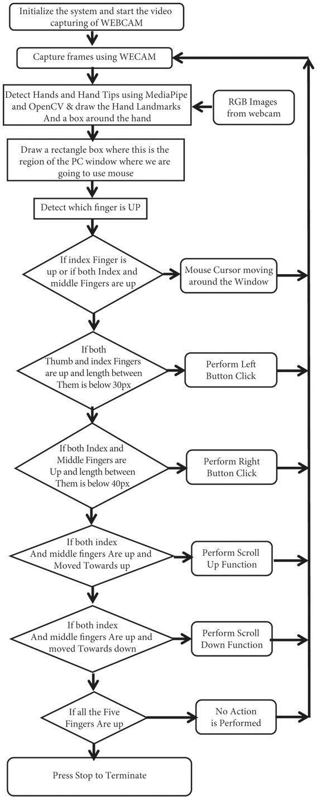
Data Flow Diagram

Slide 9




Applications and Use Cases
Accessibility
Remote Work
Gaming
Healthcare
Providing an alternative input method for individuals with physical disabilities or limitations.
Enabling hands-free control and navigation during video conferences or presentations.
Enhancing gameplay experience by offering precise cursor control and hands-free navigation.
Improving hygiene and reducing cross-contamination in medical settings.

Slide 10
Software Requirements:
VSCODE EDITOR.
OPEN-CV LIBRARY.
NUMPY LIBRARY.
MEDIAPIPE LIBRARY
AUTOPY LIBRARY

Slide 11
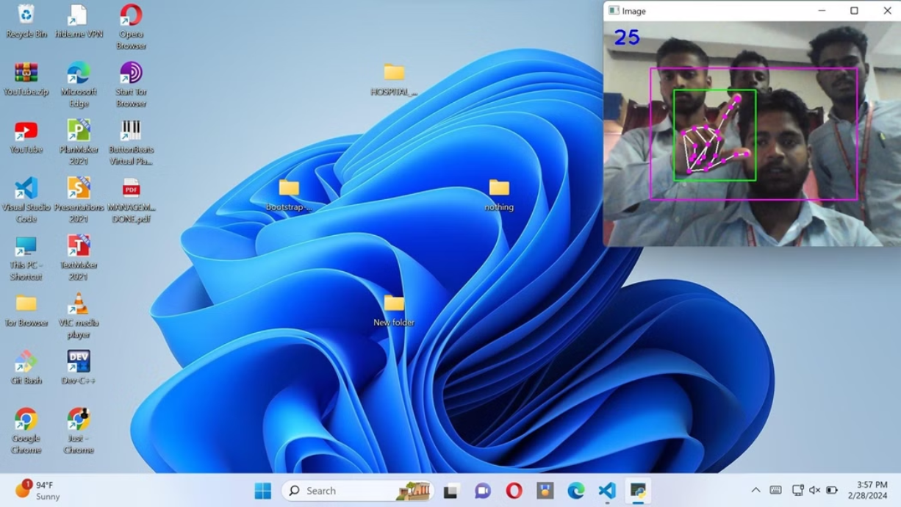
Single Click

Slide 12

Double Click

Slide 13
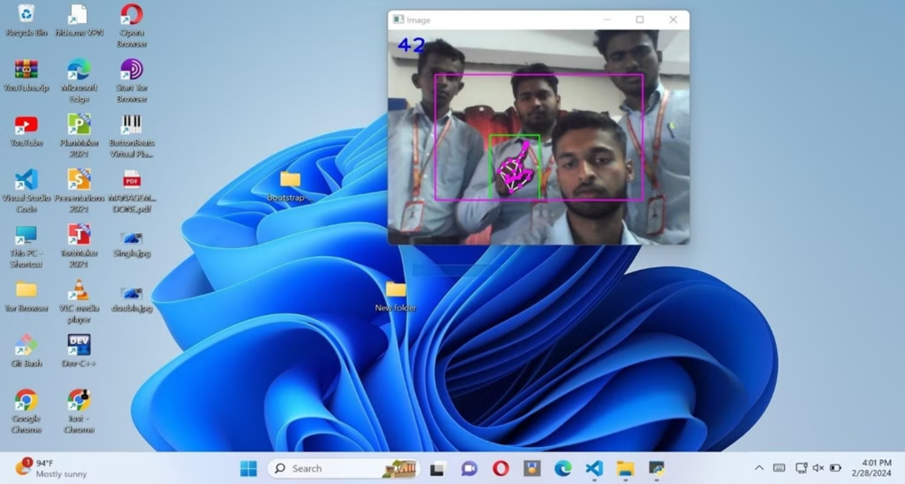
Drag and Drop

Slide 14
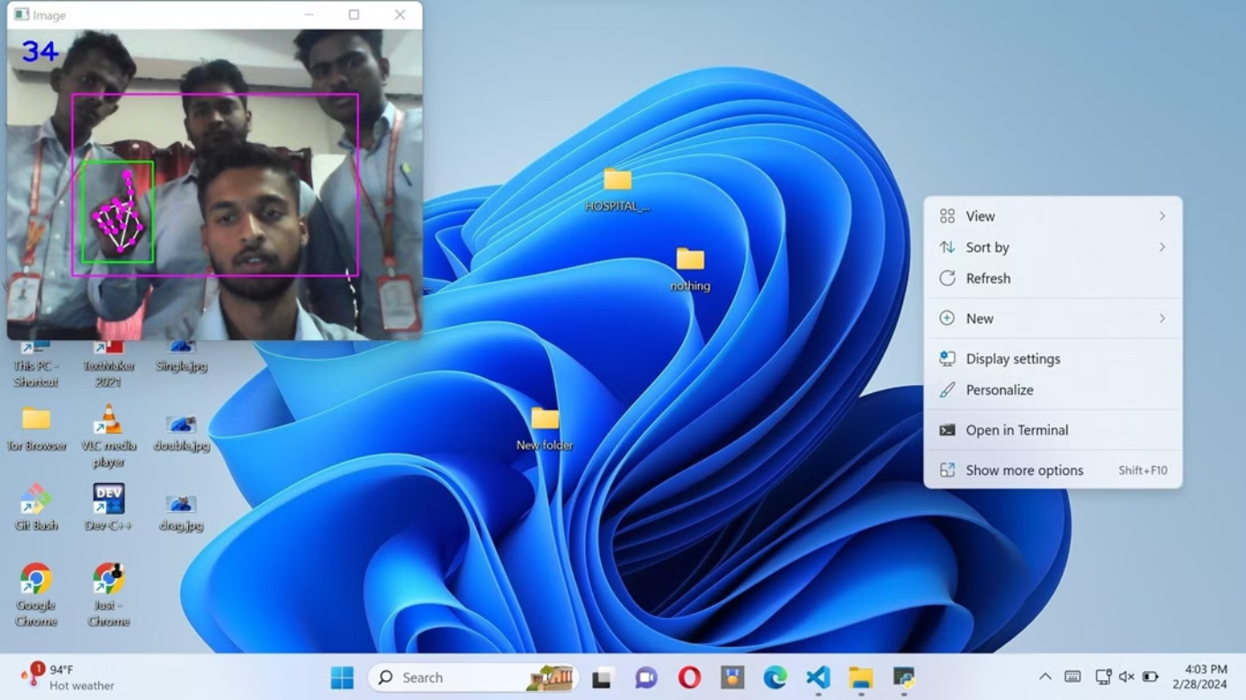
Right Click

Slide 15
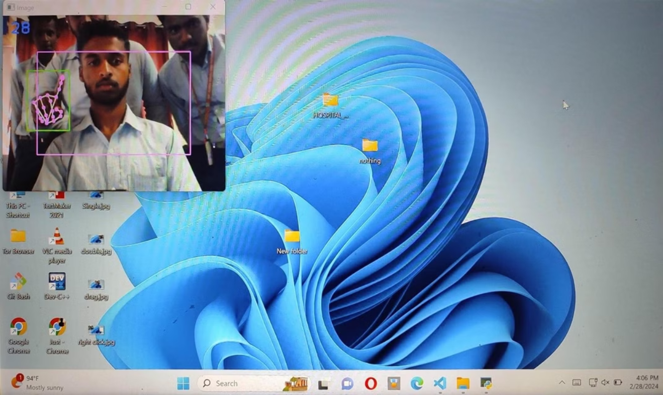
Movement

Slide 16
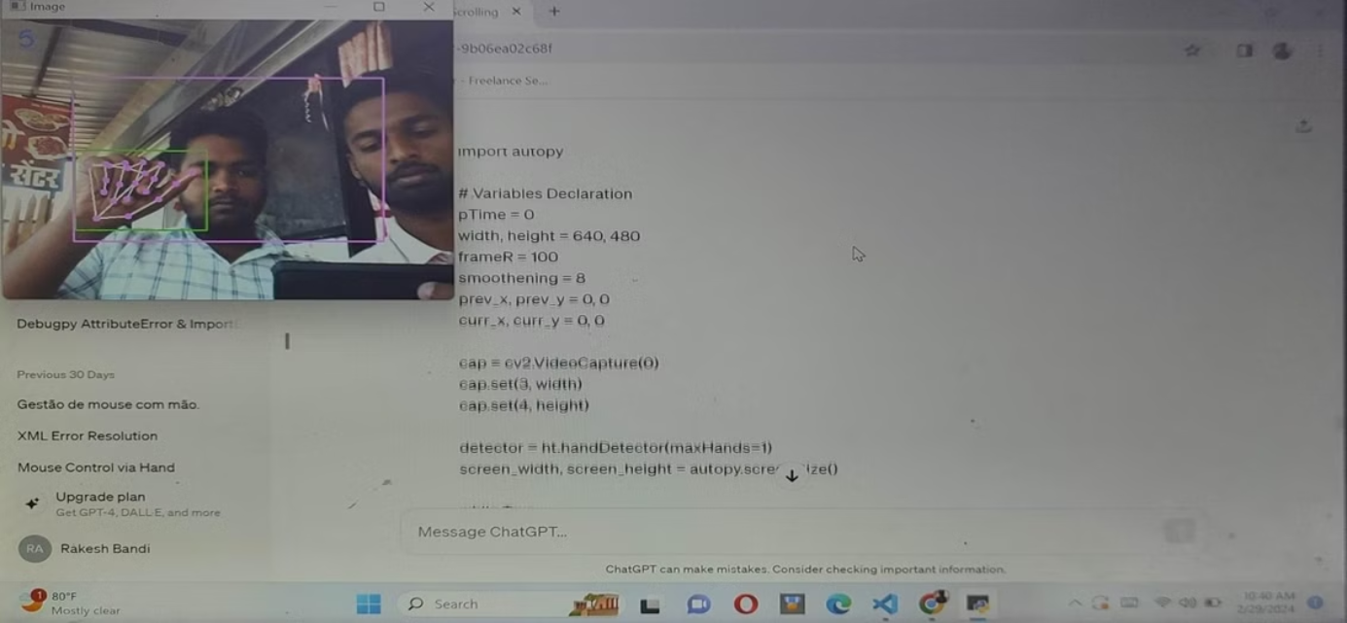
Scrolling

Slide 17
THANK YOU

